Slide 1



LOAN DEFAULT PREDICTION
“AN AI BASED PROJECT TO PREDICT LOAN APPROVAL”

Slide 2

GROUP- 08
MEMBERS
RAAMANJAL SINGH GANGWAR
NIRMAL KUMAR
PIYUSH VISHWAKARMA
PRAVEER SINGH
OM PRAKASH KANNAUJIYA

Slide 3

INTRODUCTION
In this project, we leverage machine learning classification algorithms to predict whether a loan applicant is likely to default based on their demographic, financial, and credit-related information. The use of these predictive models can help financial institutions make more informed, data-driven lending decisions.

Slide 4

PROBLEM STATEMENT
Banks and financial companies often give loans to people, but some people fail to pay them back — this is called a loan default. Predicting who might default is very important to reduce losses and make better lending decisions.
The goal of our project is to build a machine learning model that can predict whether a person will repay the loan or not, based on their information like income, job, loan amount, credit history, etc.

Slide 5



METHODOLOGY
Logistic Regression Accuracy
Decision Tree Accuracy
Random Forest Accuracy

Slide 6
METHODOLOGY
1.DATA PREPARATION
We cleaned the dataset by handling missing values and converting categorical data using encoding techniques. Unnecessary columns were removed, and exploratory analysis was done using visualizations and correlation analysis to understand patterns in the data.

Slide 7
METHODOLOGY
2.MODEL BUILDING & EVALUATION
We applied classification algorithms like Decision Tree, and Random Forest. The models were trained and tested using evaluation metrics like accuracy and F1-score. Random Forest gave the best performance, and feature importance showed that credit history, loan amount, and income were key predictors.

Slide 8
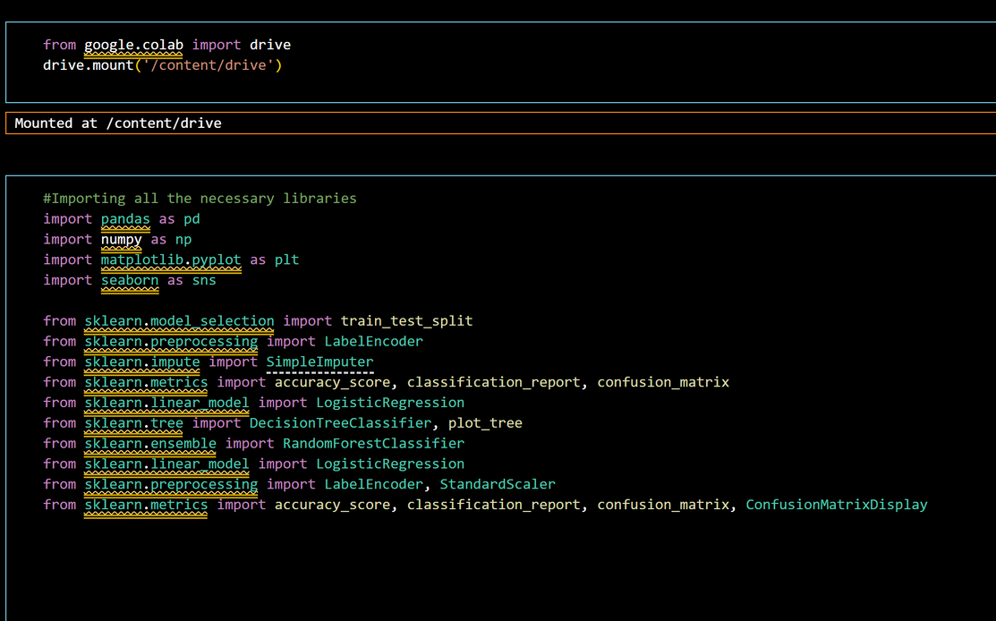
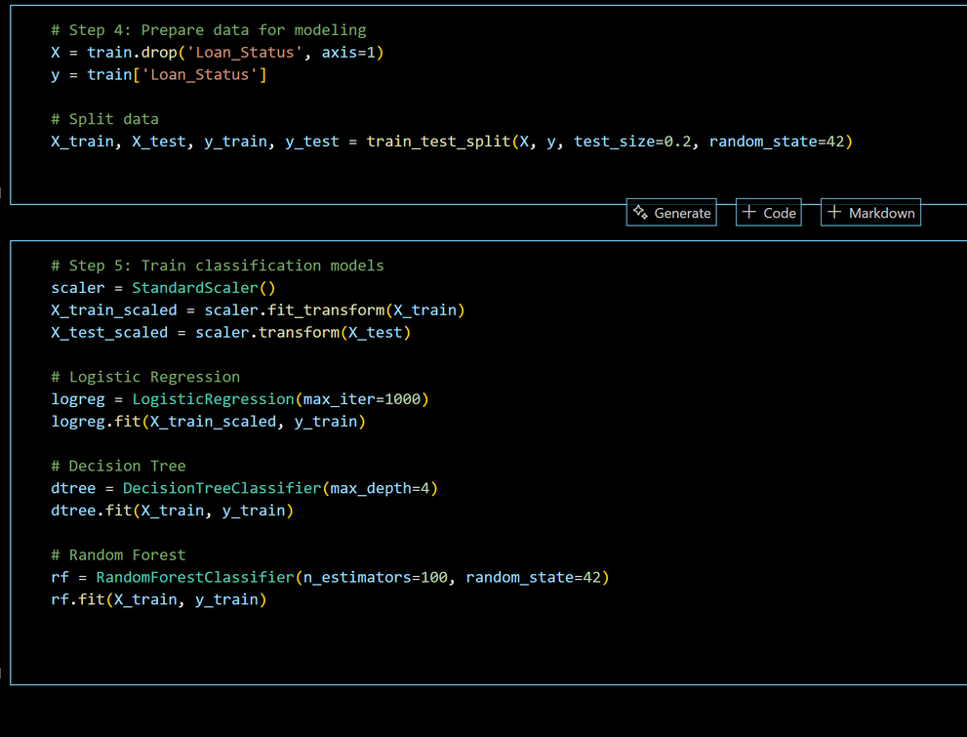
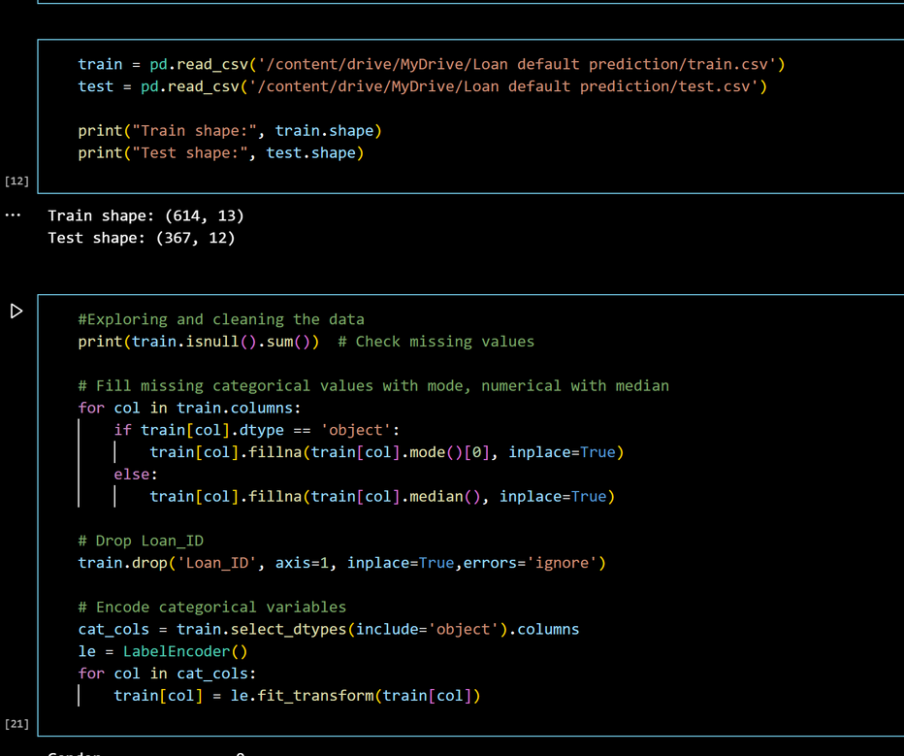
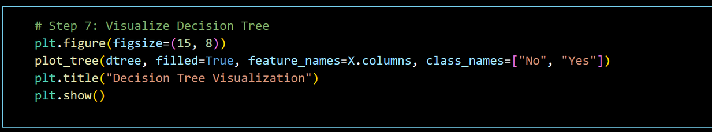
CODE

Slide 9
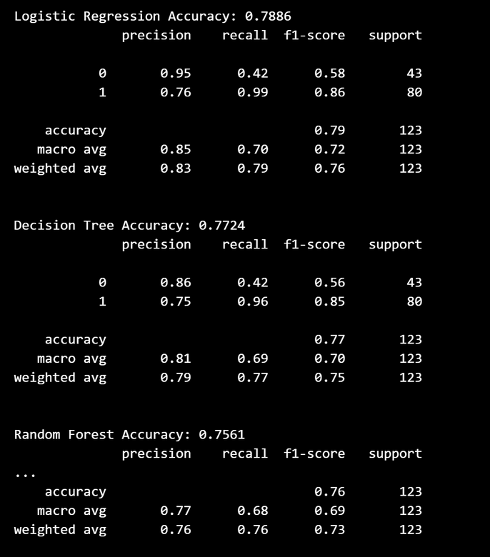
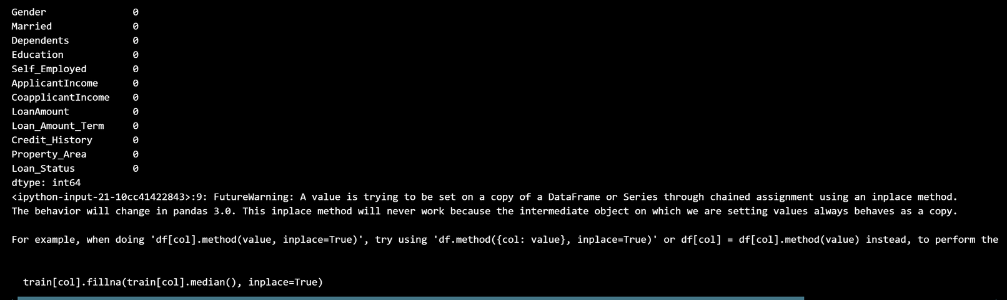
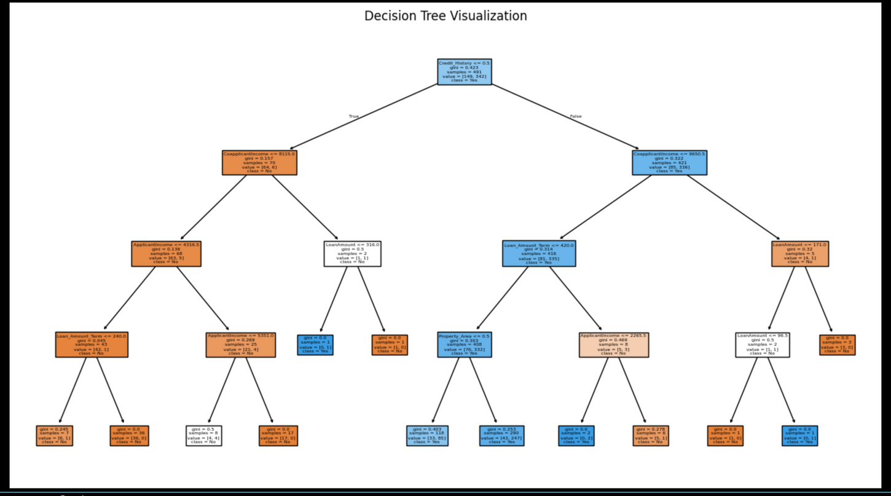
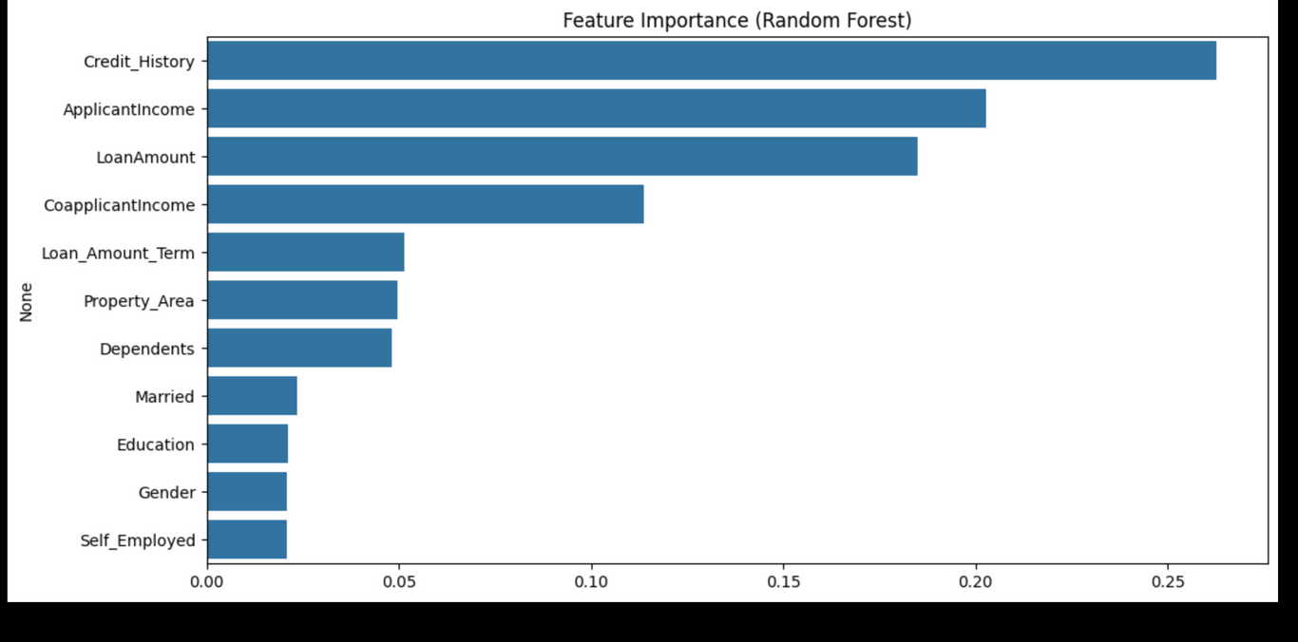
OUTPUT

Slide 10
THANK YOU

